Slide 1

Exploring register universals on the unrestricted web
Saara Hellström, Liina Repo, Valtteri Skantsi & Veronika Laippala
University of Turku & University of Oulu

Slide 2
Our study
Language use on the English, Finnish, French and Swedish web
Focus on registers
situationally defined text varieties such as news, reviews, columns and advice (Biber, 1988)
Register universals
similar patterns of variation across languages (Biber, 2014)

Slide 3
Research in register universals
Variation in language use across languages
different linguistic characteristics
different situations of language use
Register studies within one language, e.g.,
English (e.g., Biber, 1988; Biber & Egbert, 2016, 2018)
Spanish (Parodi, 2007)
Czech (Cvrček et al., 2020)
Register universals give a wider perspective on language use and its variation
Oral vs written language
Narrative vs non-narrative language

Slide 4
Material
Register classes
How-to/instructions
E.g., recipes
Interactive discussion
E.g., discussion forums
Informational description
E.g., encyclopedia articles
Informational persuasion
E.g., promoting texts
Narrative
E.g., news, personal blogs
Opinion
E.g., advice, opinion blogs
Lyrical
E.g., song lyrics, poems
Spoken
E.g., formal speeches
Four corpora representing the unrestricted web
Corpus of Online Registers of English (CORE;
Biber, Egbert & Davies, 2015) (40,944 documents)
FinCORE (8,373 documents) (Laippala et al., 2019)
FreCORE (1,446 documents) (Repo et al., 2021)
SweCORE (1,676 documents) (Repo et al., 2021)
➔ manually annotated following the hierarchical annotation scheme for CORE
➔ similar material and classification
→ direct comparison possible
We focus on the narrative register

Slide 5
Methods
Supervised machine learning (text classification) & linguistic analysis of the most important features estimated by the classifier for the registers
For each language, we
1) trained a linear classifier to predict the register classes based on the grammatical features of the documents,
2) extracted the most important features estimated by the classifier for the registers, and
3) compared these features between the languages
About the differences between the classification and MDA, see Egbert & Biber (2018)

Slide 6
Classifier
Support Vector Machine used as classifier *
The classifier was run 100 times
between every run the data was randomly divided into train and test
after every run the best 500 features were saved
30 most frequent features in the final analysis
represents the entire data
The syntactic features of the documents used as predictors of the classifier
grammatical information was produced with state-of-the-art dependency parsers (Kanerva et al., 2018) which follow the language independent Universal Dependency scheme (Nivre et al. 2016)
Classification results
EN | FI | FR | SW
52% | 57% | 55% | 64%
*Scikit-learn LinearSVC; l2 penalty; EN c=0.01; FR: c=0.1; FI c=0.01; SV: c=0.01, max_iter=10000, countvectorizer, min_df=0.05

Slide 7
Analysis

Slide 8
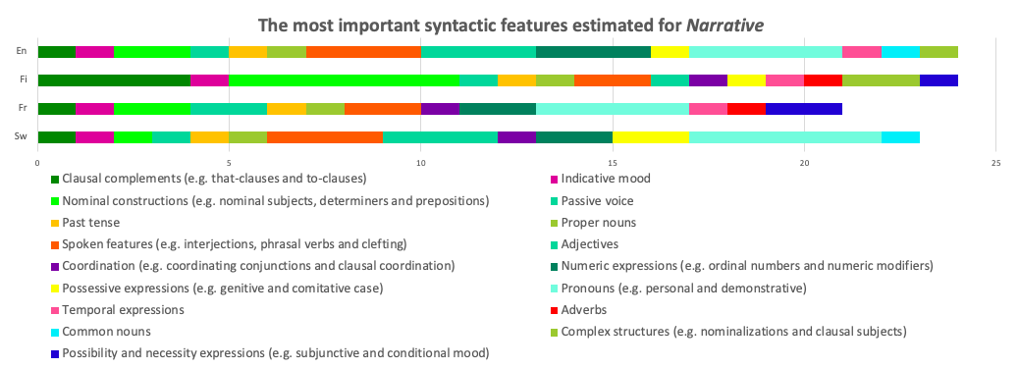
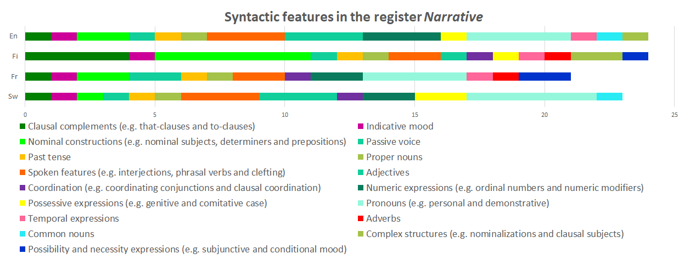

Slide 9
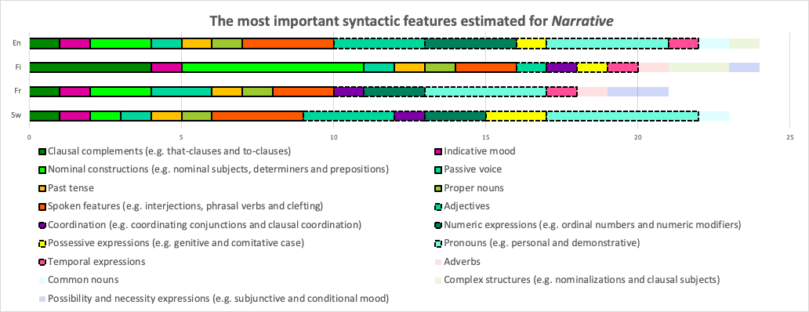
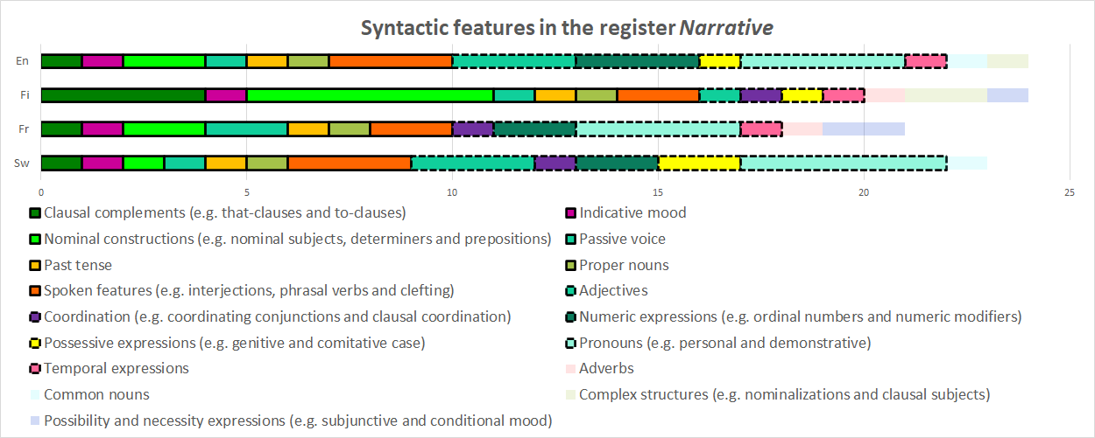

Slide 10
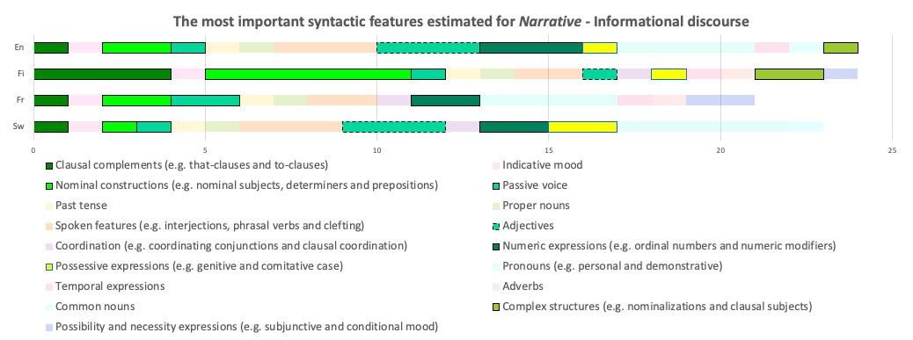
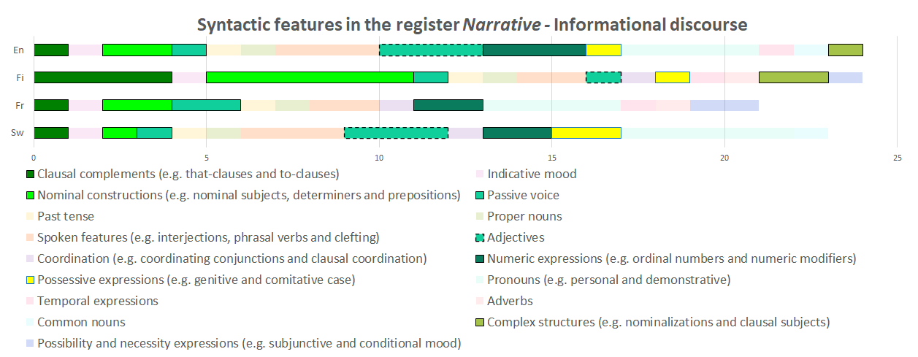
Besnier (1988)
Biber & Egbert (2016)
Biber & Egbert (2018)
Kanoksilapatham (2007)

Slide 11
Examples of informational features
English:
Gatland, who was unveiled as the Lions' boss earlier this week, has hinted that outstanding club form could be enough to book a place on the plane Down Under with the likes of former England internationals Jonny Wilkinson and Mike Tindall on his radar.
Finnish:
Oulussa on opittu, että paras hetki neuvontaan on heti rakennushankkeen alussa, kun vasta mietitään valintoja.
[It has been learned in Oulu that the best time for counseling is right at the beginning of a construction project, when choices are just being considered.]
French:
De même, aucune date d'interdiction de ce métal dans les amalgames dentaires n'a été précisée, sous la pression du lobby des dentistes qui ont cependant admis que son utilisation doit diminuer.
[Similarly, no date for the ban of this metal in dental amalgams has been specified under the pressure from the lobby of dentists who have admitted, however, that its use must decrease.]
clausal complement, nominal constructions, passive voice, adjective, possessive expression

Slide 12
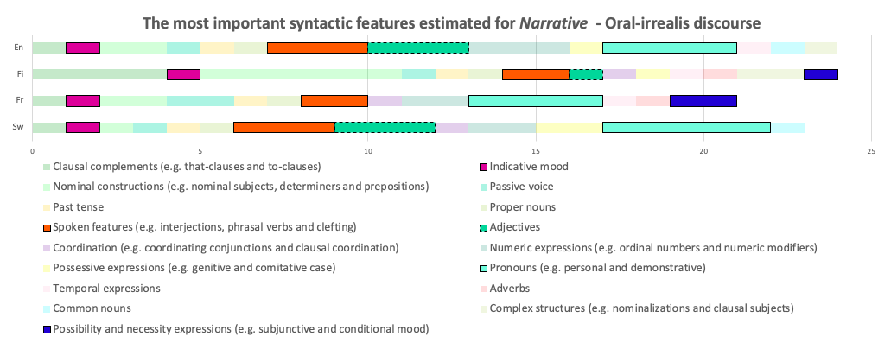
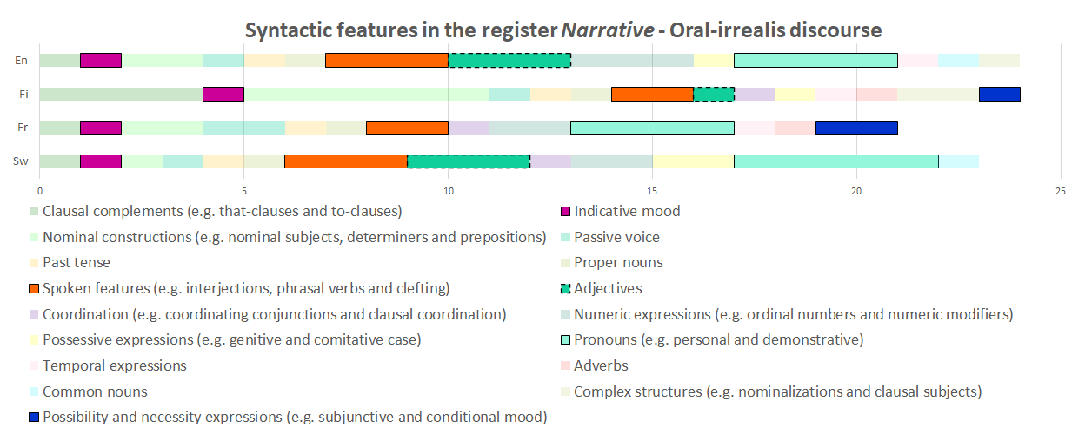
Biber & Egbert (2016)
Parodi (2007)

Slide 13
Examples of oral + irrealis features
Finnish:
Olen sitä mieltä, että ihmiset voisivat peremmin [sic], jos tekisivät enemmän meditatiivisia asioita ja ylipäätään asioita käsillään: golfissa on molemmat aspektit mukana!
[In my opinion, people would feel better if they did more meditative things and generally things with their hands: golf includes both aspects!]
French:
Et ce qui me surprend le plus... c'est la vitesse a [sic] laquelle on consomme!!
[What surprises me the most… is the speed at which it is consumed!!]
Swedish:
Ja grattis till utmärkelsen! Det var så jag hittade hit för någon vecka sedan.
[Yes congratulations for the award! That’s how I found this site for a couple of weeks ago.]
pronoun, spoken features (interjection, dislocation, cleft,
parataxis), adjective, possibility and necessity expressions
(conditional mood), indicative mood

Slide 14
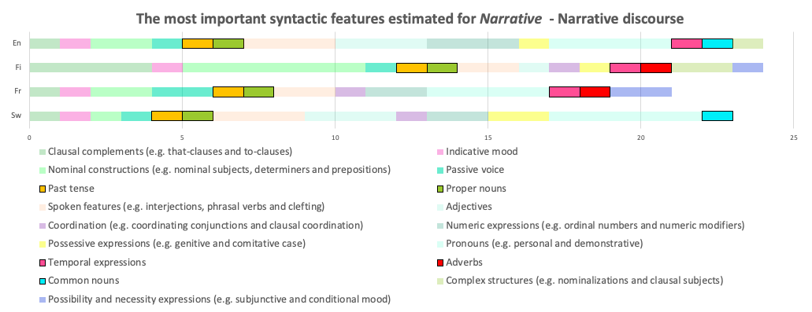
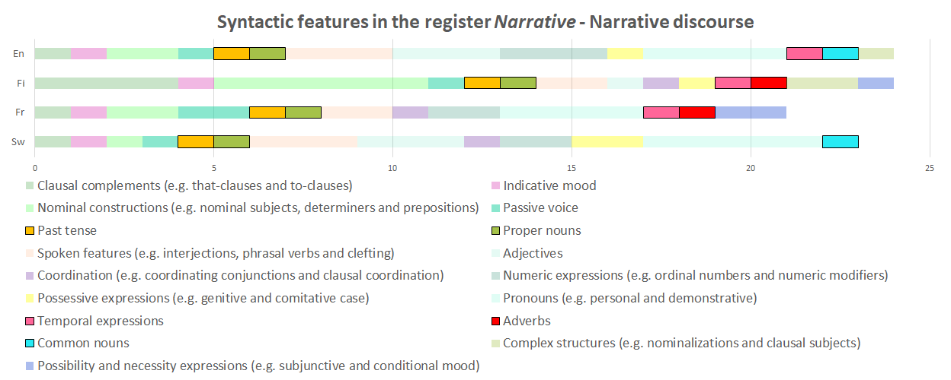
Biber & Egbert (2016)

Slide 15
Examples of narrative features
Finnish:
Australiassa ollessa pyysin pojille myös Suomen rokotusohjelmaan kuuluvat suojarokotteet.
[While in Australia I asked for the boys also the vaccines that are part of Finland’s vaccine program.]
Swedish:
Men ofta saknar de både pass och id-kort och sedan några år har inga avvisningar gjorts eftersom Marocko har valt att inte ta emot papperslösa.
[But they often lack both passports and ID cards and during the past couple of years no one has been turned back since Morocco has decided not to receive any paperless migrants.]
proper nouns, temporal expressions, past tense, common nouns, adverbs

Slide 16
The most frequent adjectives
English | Finnish | Swedish
other | toinen | annan
new | uusi | ny
good | hyvä | bra
old | vanha | gammal
own | oma | egen
little | pieni | liten
first | ensimmäinen
 | suuri, iso | stor
many |  | många
 | koko | hel
last | viime
long | pitkä
great |  | fin
well | sellainen | själv
same | eri | en
best | tärkeä | svensk
more |  | olik
 |  | sen

Slide 17
Conclusions
Informational, oral-irrealis and narrative features are prominent in narrative web registers in the studied languages
Pointers to new register universals?
Irrealis and informational
Adjectives are very similar between languages
What next?
Register universals in sub-registers
➜ more homogenous classes
Register universals in multilingual neural net models
What kind of linguistic features the models pay attention to?
How multilingual models differ from monolingual models qualitatively? What does this tell about registers?

Slide 18
References
Besnier, N. (1988). The Linguistic Relationships of Spoken and Written Nukulaelae Registers. Language, 64:707–736.
Biber, D. (1988). Variation Across Speech and Writing. Cambridge University Press.
Biber, D. (2014). Using Multi-dimensional Analysis to Explore Cross-linguistic Universals of Register Variation. Languages in Contrast, 14(1), 7–34.
Biber, D., & Egbert, J. (2016). Register variation on the searchable web: A multi-dimensional analysis. Journal of English Linguistics, 44(2), 95–137.
Biber, D., & Egbert J. (2018). Register variation online. Cambridge University Press.
Biber, D., Egbert, J., & Davies, M. (2015). Exploring the composition of the searchable web: A corpus-based taxonomy of web registers. Corpora,, 10(1), 11–45.
Cvrček, V., Komrskova, Z., Lukes, D., Poukarová, P., Řehořková, A, Zasina, A., & Benko, V. (2020). Comparing web-crawled and traditional corpora. Language Resources and Evaluation, 54(10), 713–745. https://doi.org/10.1007/s10579-020-09487-4.
Egbert, J., & Biber, D. (2018). Do all roads lead to Rome? Modeling register variation with factor analysis and discriminant analysis. Corpus Linguistics and Linguistic Theory, 14(2), 233–273.
Kanerva, J., Ginter, F., Miekka, N., Leino, A., & Salakoski.T. (2018). Turku Neural Parser Pipeline: An end-to-end system for the CoNLL 2018 Shared Task. In D. Zeman & J. Hajič (Eds.), Proceedings of the CoNLL 2018 Shared Task: Multilingual parsing from raw text to universal dependencies (pp. 133–142). Association for Computational Linguistics. https://doi.org/10.18653/v1/K18-2013.
Kanoksilapatham, B. (2007). Rhetorical Moves in Biochemistry Research Articles. In D. Biber, U. Connor and T. A. Upton (Eds.). Discourse on the Move: Using Corpus Analysis to Describe Discourse Structure (pp. 73–120). John Benjamins.
Laippala, V., Kyllönen, R., Egbert, J., Biber, D., & Pyysalo, S. (2019). Toward multilingual identification of online registers. In M. Hartmann & B. Plank (Eds.), Proceedings of the 22nd Nordic Conference on Computational Linguistics (pp. 292–297). Linköping University Electronic Press.
Nivre, J., de Marneffe, M.-C., Ginter, F., Goldberg, Y., Hajič, J., Manning, C .D., McDonald, R., Petrov, S., Pyysalo, S., Silveira, N., Tsarfaty, R. & Zeman, D. (2016). Universal Dependencies v1: A Multilingual Treebank Collection. Proceedings of the 10th International Conference on Language Resources and Evaluation (LREC). https://www.aclweb.org/anthology/L16-1262.pdf
Parodi, G. (2007). Variation across Registers in Spanish. In G. Parodi (Ed), Working with Spanish Corpora (pp. 11–53). Continuum.
Repo, L., Skantsi, V., Rönnqvist, S., Hellström, S., Oinonen, M., Salmela, A., Biber, D., Egbert, J., Pyysalo S., & Laippala, V. (2021). Beyond the English web: Zero-shot cross-lingual and lightweight monolingual classification of registers. Proceedings of the EACL 2021 Student Research Workshop, (pp. 183–191). Association for Computational Linguistics.

Slide 19

Thank you!

